Slide 1
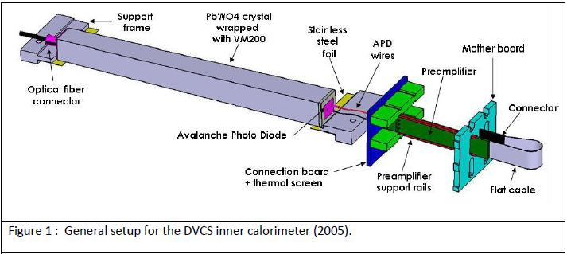
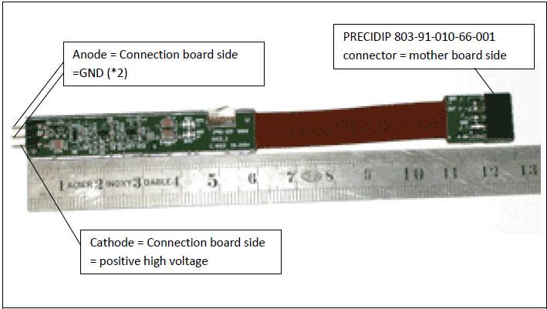
Ecal Connection board and Motherboard design

Slide 2
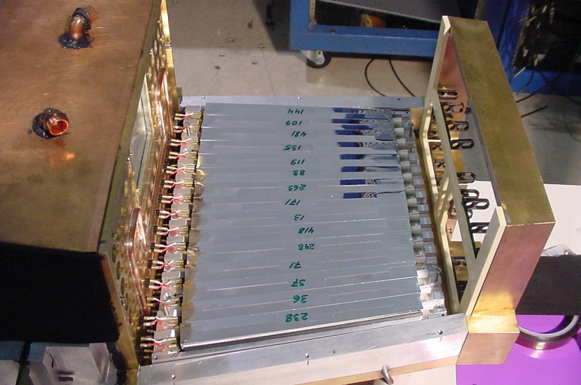
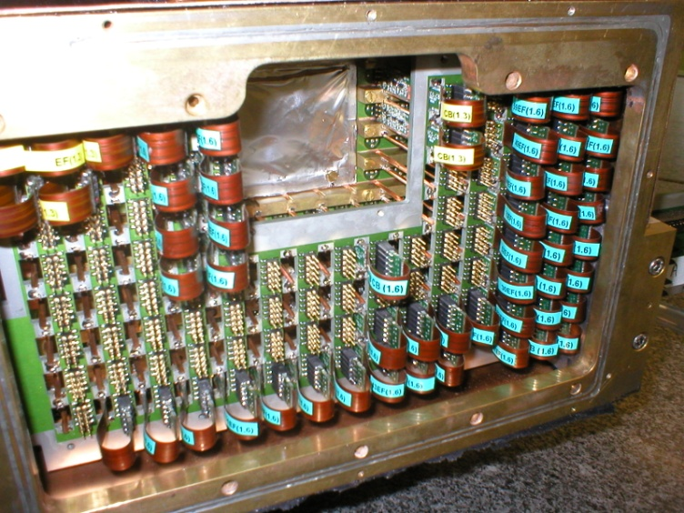
Connection Board
Motherboard

Slide 3
Connection Board
The connection board links the APD on one side and Preamplifier on the other side:
Connection from the APDs to the Board is by 2 twisted wires.
Connection from the Board to Amplifier is by 3 pin socket.
There are also preamplifier support rails soldered on the board to hold the amplifiers in place.
The board provides thermal screen and provides ground link between the APD and preamplifiers.
46 Crystals across ~ 736mm (29in)
16mm
16mm
B
A
10 Crystals high ~ 160mm (6.3in)
21 Crystals
25mm
21 Crystals
C
D
23 Crystals
23 Crystals
x
23 Crystals
y
111 Crystals per Quadrant
Total Crystals = 444

Slide 4
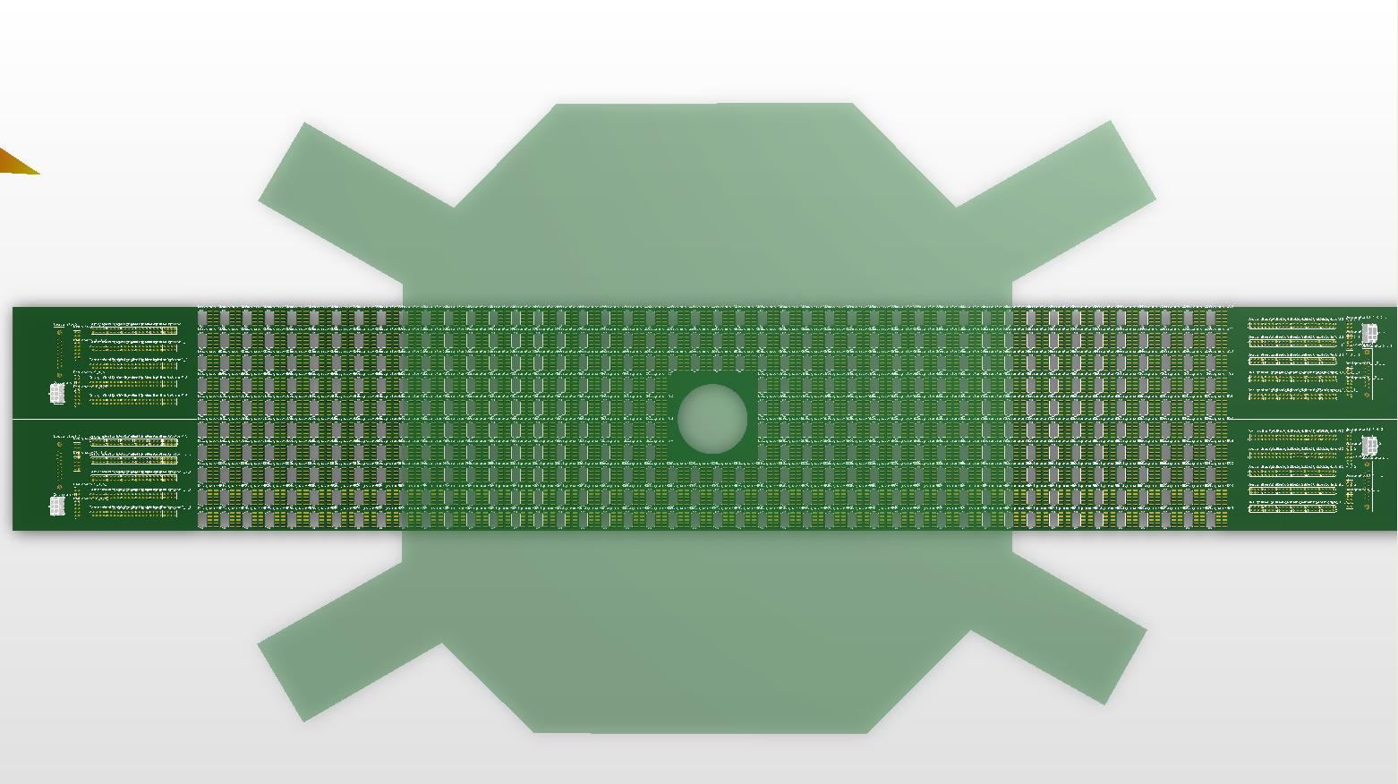
Slotted Motherboard
DVCS 2005 Inner Calorimeter Motherboard
HPS ECal Motherboard

Slide 5
986mm (38.8in)
125mm (4.92in)
Quadrant B
Connectors
B
A
Quadrant A
Connectors
111 Crystals
111 Crystals
50mm
160mm (6.3in)
Quadrant C
Connectors
C
D
Quadrant D
Connectors
111 Crystals
111 Crystals
8-Pin Connectors
High Voltage Connector
8-Pin Connector
(HE804EN17YOA401)
Preamp
signals
Low Voltage Connector
8-Pin Connector
(Molex_43045-0612)

Slide 6
786mm (31in)
Quadrant B Connectors
Quadrant A Connectors
B
A
111 Crystals
111 Crystals
220mm (8.7in)
HV/LV Connectors
50mm
HV/LV Connectors
C
D
111 Crystals
111 Crystals
Quadrant C Connectors
Quadrant D Connectors
8-Pin Connectors
High Voltage Connector
(HE804EN17YOA401)
Preamp
signals
Low Voltage Connector
(Molex_43045-0612)

Slide 7
Slotted Motherboard
46 Crystals across ~ 736mm (29in)
16mm
16mm
80mm (3.15in)
5 Crystals high ~ 80mm (3.15in)
25mm
21 Crystals across ~ 336mm (13.2in)
GND
GND
Board Cutout
GND
Signal
Connector Footprint
12.6mm
+5V
GND
-5V
GND
GND
HV
6.3mm
16mm

Slide 8
Proposed non-slotted Motherboard
The preamplifier output signals have to be sandwiched between two ground strips (on the motherboard) to reduce crosstalk.
This increases routing complexity.
To reduce noise on the signals, the following Motherboard design is proposed:
Move the existing APD connector to the backside of the motherboard (side with the APD).
Put a LEMO connector on the frontside of the motherboard.
Connect directly to the readout boards from the from motherboard.
To Readout
Module
Crystal
Preamplifier
Connection Board
Motherboard

Slide 9
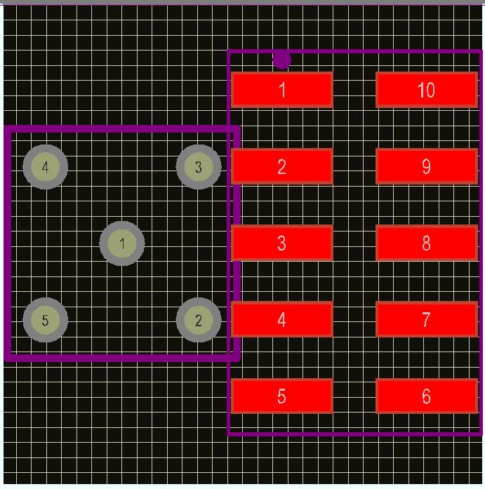
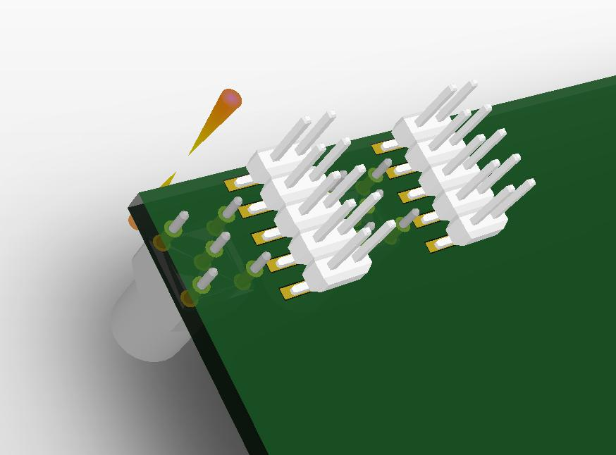
Backside View
46 Crystals across ~ 736mm (29in)
16mm
16mm
80mm (3.15in)
5 Crystals high ~ 80mm (3.15in)
25mm
21 Crystals across ~ 336mm (13.2in)
GND
GND
GND
Signal
Precidip 802-PP-NNN-10-001101
Connector Footprint
(12.7mm X 8.5mm)
Lemo EPB.00.250.NTN
Connector Footprint
(7mm X7mm)
+5V
GND
-5V
GND
GND
HV
16mm

Slide 10
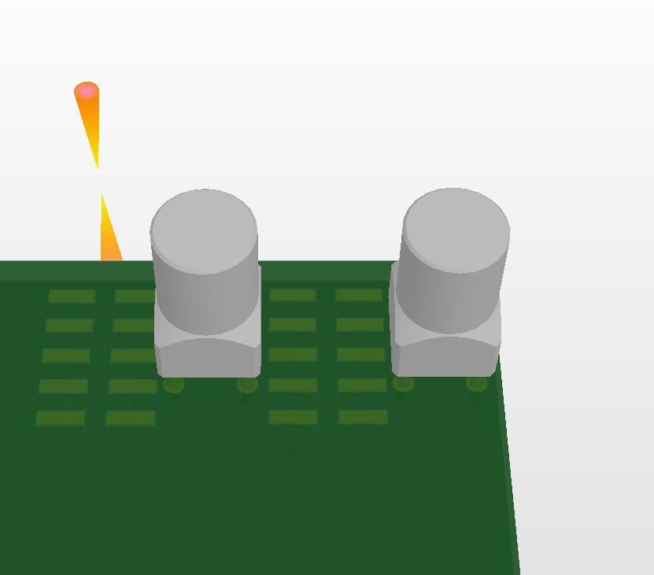
Frontside View
46 Crystals across ~ 736mm (29in)
16mm
16mm
HV & LV Connectors
80mm (3.15in)
5 Crystals high ~ 80mm (3.15in)
25mm
21 Crystals across ~ 336mm (13.2in)
LEMO EPB.00.250.NTN
Connector Footprint (7mm X 7mm)
Not to scale
16mm

Slide 11
Summary
Discussion of alternative motherboard design.
How does it affect Mechanical design by adding ~ 6inches separation between motherboard and connection board?
Slotted vs non-slotted
Pros
Easier design = Less labor during routing.
Reduce Signal Integrity concerns.
Access to individual crystal signal for readout.
Slotted motherboard is flimsier.
Cons:
Might need another “dummy” slotted board to support the preamp.
Lemo connectors ~ $10 each.

Slide 12
Questions and/or Comments

